Slide 1
Data Discovery Tool (DDT) QAQC Modifications
Quick Guide
2017-09-21

Slide 2
Installing
Uncompress zip file (DDT_v1_1_3.zip) to your computer.
Install R
https://cran.r-project.org/
In R, add libraries
Run xxx.R
This script installs all necessary libraries for the DDT to run.

Slide 3
Install packages in R
Install libraries using the R code below.
Will need to run both portions.
Will need internet connection.
# libraries to be installed
data.packages = c("assertthat" , "base64enc" , "chron" , "data.table" , "dataRetrieval" , "DBI"
, "devtools" , "dplyr" , "DT" , "ggplot2" , "git2r" , "htmlwidgets" , "httpuv" , "httr" , "jsonlite" , "lazyeval"
, "leaflet" , "lubridate" , "memoise" , "openssl" , "png" , "R6" , "raster"
#, "rCharts" #non-CRANN
, "readr"
, "rstudioapi" , "scales" , "shiny" , "shinyBS" , "sourcetools" , "sp" , "stringr" , "tibble" , "whisker"
, "withr" , "xml2" , "xtable" , "XLConnect" )
# install via lapply
lapply(data.packages,function(x) install.packages(x))
# Install non-CRAN packages from GitHub
require(devtools)
install_github("ramnathv/rCharts")
install_github('rstudio/DT@feature/editor')

Slide 4
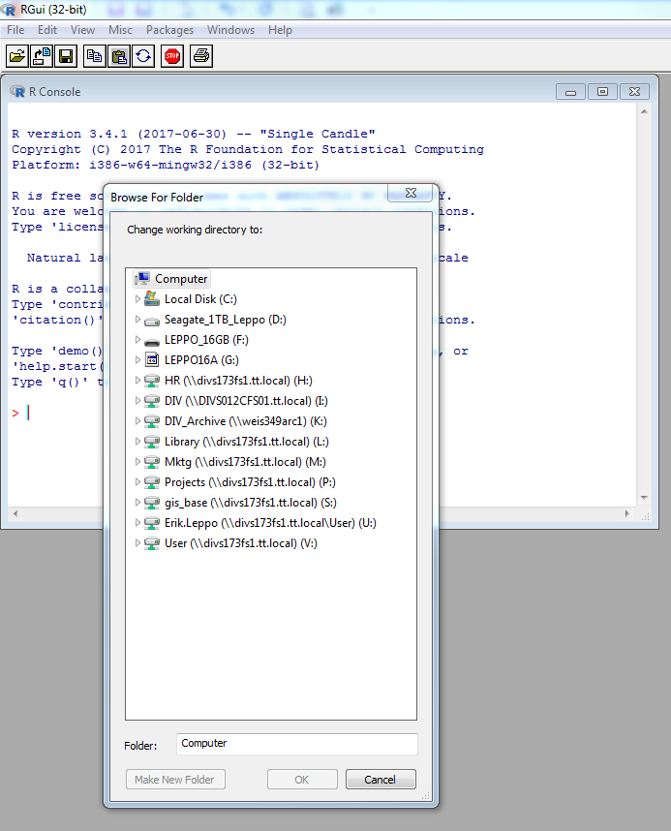
Starting the DDT
Launch R
Change Directory
Menu bar
File – Change Directory
Choose location of unzipped DDT files.
Run the app with R code below.
Copy and paste (or type) into the console in R.
(At the red “>” in the screen shot)
require(shiny)
runApp(launch.browser = T)

Slide 5
DDT – QAQC Mod
The DDT will launch in your web browser (e.g., IE, Firefox, Chrome, etc).
If “QAQC Mod” appears in the DDT title you have the version with the QAQC modifications.

Slide 6
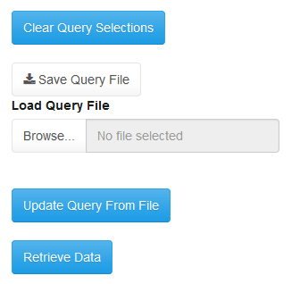
Query Data
Clear Query Selections
Deletes contents of all boxes.
Save Query File
Saves the current query to a file for use later.
The user is given the option of changing the file name and location.
Browse
Select a saved query file.
Update Query from File
Updates all boxes with the file selected by Browse

Slide 7
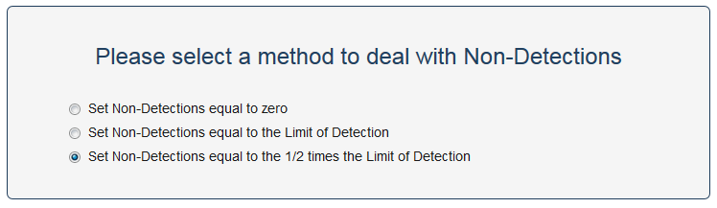
Check Data
Home
Non-Detects
The Non-Detects section was modified to set the default at ½ time the Limit of Detection.

Slide 8
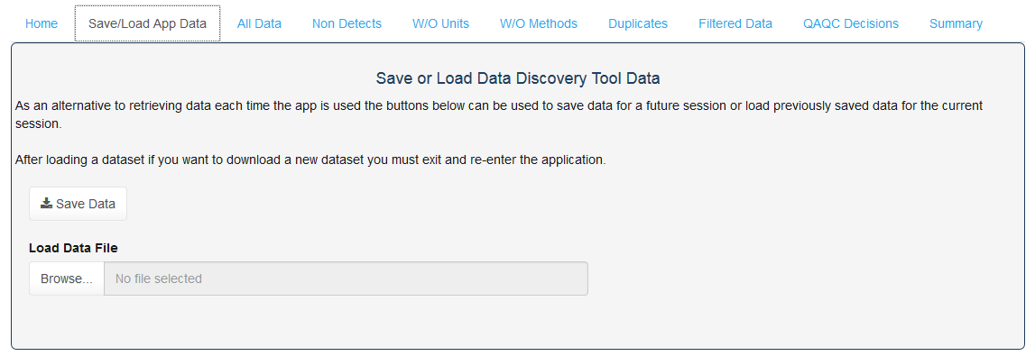
Check Data
Save/Load App Data
Save Data
Saves the current data to a file for use later.
The user is given the option of changing the file name and location.
Browse
Select a saved data file and loads it into the App
After loading check the “All Data” tab to see the data.
In some rare cases it is necessary to exit the app and then load the data into a fresh session.

Slide 9
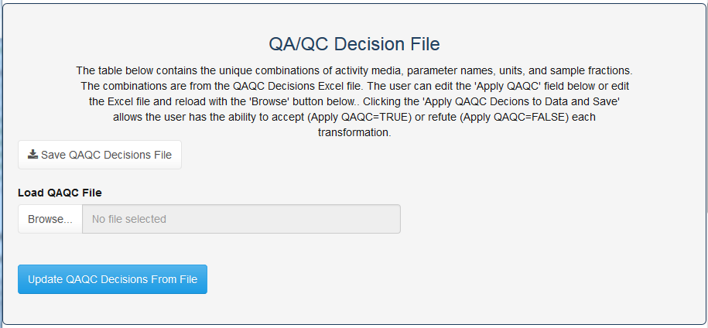
Check Data
QAQC Decisions
Save QAQC Decisions File
Saves the current data to an Excel file for use later.
The user is given the option of changing the file name and location.
Browse
Select a saved data file and loads it into the App
Update QAQC Decisions From File
Updates the QAQC Decisions table with the file selected by Browse

Slide 10
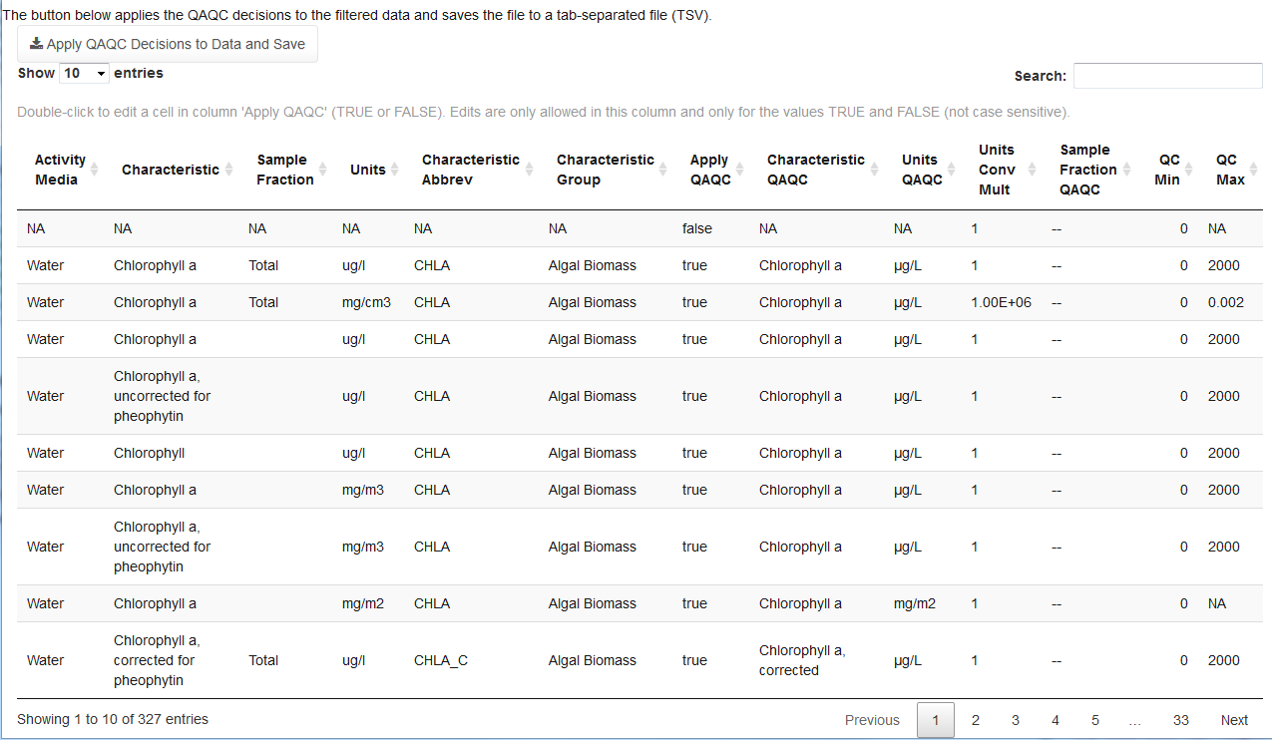
Check Data
QAQC Decisions
Table
Combinations of media, characteristic, sample fraction, and units
Apply QAQC column editable for True/False as to whether to use this rule on your data
Defaults loaded at start up
Change contents (with a button) by loading a new QAQC file
Ability (with button) to add all new combinations from your data
Apply QAQC Decisions to Data and Save
This button uses the contents of the table (as shown on screen) and per the entries in the column “Apply QAQC” changes the result values in your data and saves it to a tab separated file (TSV).

Slide 11
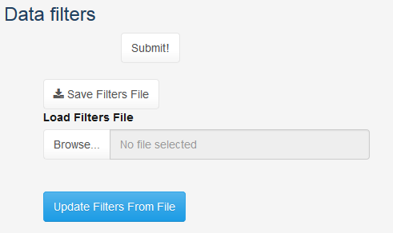
View Data
Submit!
Unchanged, still applies filters to data.
Save Filters File
Saves the current filters to a file for use later.
The user is given the option of changing the file name and location.
Browse
Select a saved filter file.
Update Filters from File
Updates all boxes with the file selected by Browse

